Slide 1

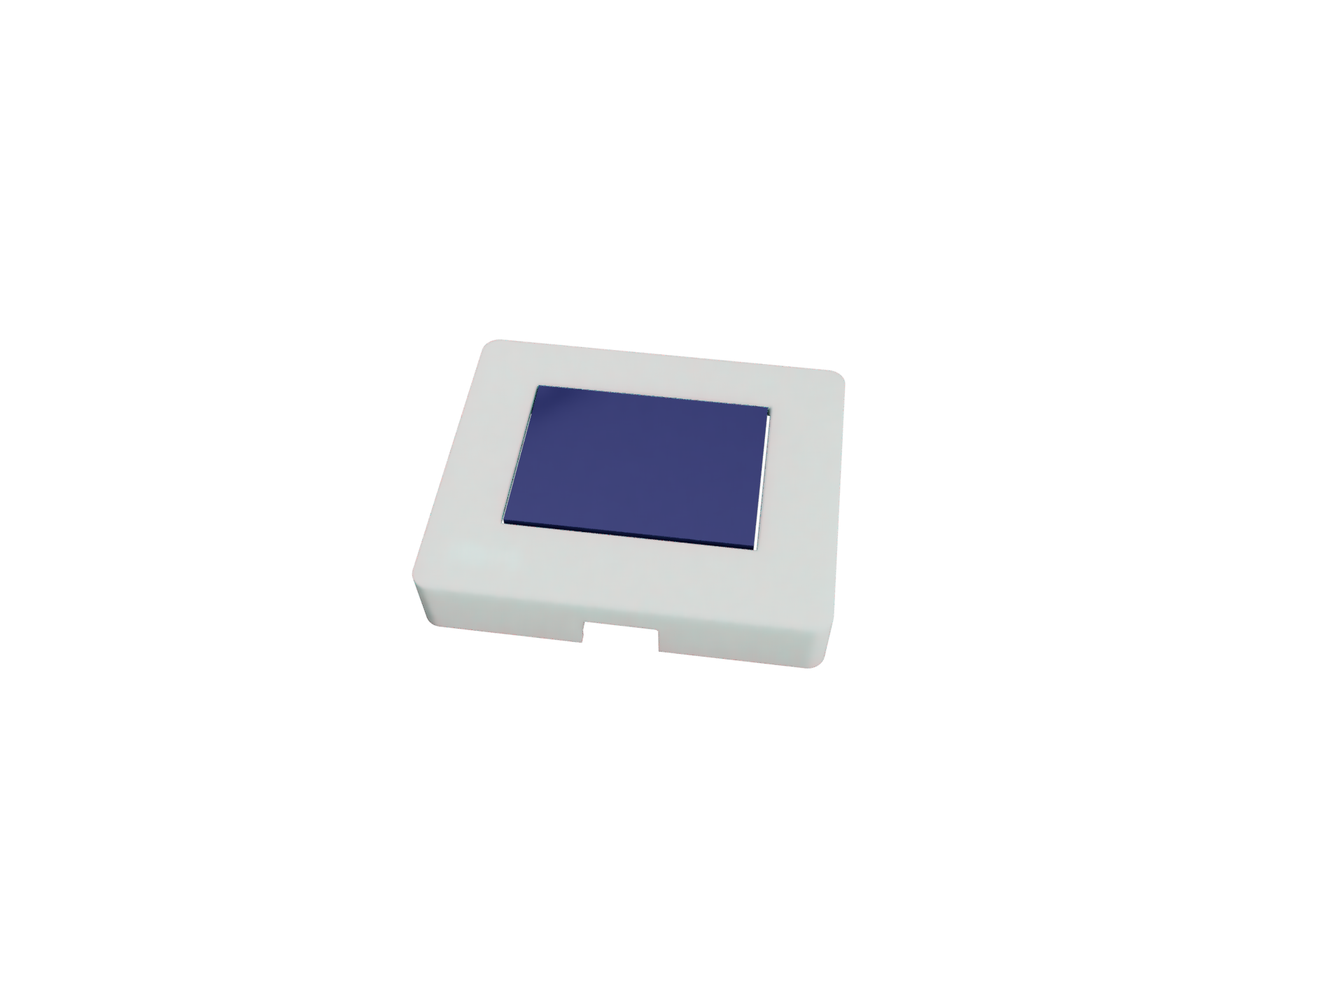
A plug and play panel with a start-to-finish user interface development experience
Software Support
Embedded System
User Designs Layout
Draw components from website
Website Generates String
Register input from i2c and touchscreen
Device requests profile
Send output data
Receive input data
String decoded into components
Send status over UART
Key features
Two wire User interface (UART)
Hardware and software components
Interchangeable tactile buttons, knobs, and sliders
Protective enclosure
Wide microcontroller compatibility
One stop shop user interface development
Upcoming changes
More i2c components
Custom port design
Detailed setup guide
Robust user examples that demonstrate everything protocontrol can do

